Slide 1


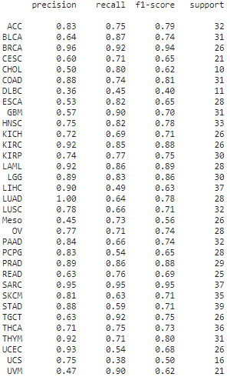
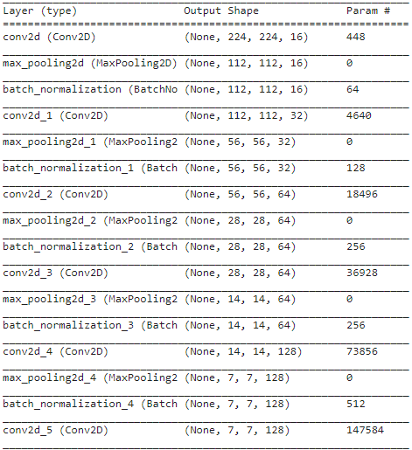
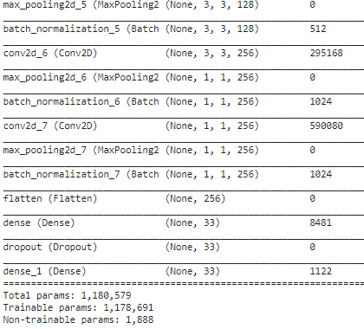
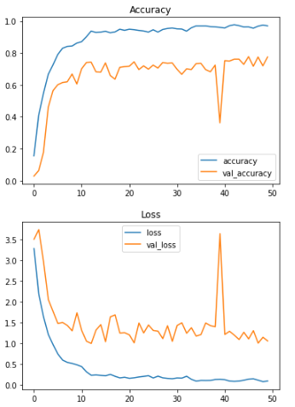
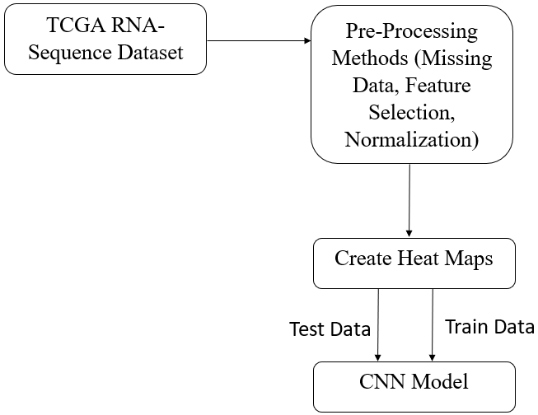
Cancer Subtype Prediction
Dileep Kumar Reddy J K Soham Kishor Misal Veerendra Patil P
r18cs511@cit.reva.edu.in r17cs404@cit.reva.edu.in r18cs535@cit.reva.edu.in
Guide Name : Dr. Nimrita Koul
Department of Computer Science and Engineering, REVA University
Abstract
Objectives
d & Amin, M.(2015). Design and Construction of a Multipurpose Robot. International Journal of Automation, Control and Intelligent Systems. 1. 34-46.
Conclusion
Results
Cancer is caused as a result of unconstrained cell growth. It has several subtypes, identification of these subtypes in a quick and efficient manner is crucial in the treatment of cancer patients. The TCGA RNA-Seq dataset is chosen for training the Deep Learning based CNN model to predict the subtypes of cancer. Several pre-processing methods are applied. The feature selection technique used is Recursive Feature Elimination, it helps select 50 genes out of the available 20,531 genes. The gene data corresponding to each patient is stored in a NumPy array. The array is then used to create heat maps. The dataset contains 33 labels. The CNN model consists of several convolutional layers, pooling layers, batch normalization layers, dense layers and dropout layer. ReLu & Softmax are the activation functions used. In order to avoid overfitting a dropout rate of 0.15 is used. The model provides a test accuracy of 73.87%.
To study the RNA-Sequence dataset
To apply data pre-processing methods on the dataset
To convert the dataset into images
To build a CNN model to predict the subtypes of cancer
.
Cancer has several subtypes, identification of these subtypes in a quick and efficient manner is crucial in the treatment of cancer patients. The deep learning-based CNN model that has been implemented in this paper has been tested on the TCGA RNA-Seq dataset. The method provides a test accuracy of 73.87% on the multiclass dataset.
Proposed Solution
Figure. 3 Accuracy, Precision, Recall, F1 Score, Cohen Kappa Score
The proposed solution is a Deep Learning based CNN model which predicts the subtypes of cancer. The architecture of the model is represented by Figure.2.1 and Figure. 2.2. The model consists of 7 convolutional layers each consisting of a kernel size of 3x3, 7 pooling layers, 7 batch normalization layers, 2 dense layers and 1 dropout layer. ReLu is the activation function used for the aforementioned layers. Softmax is the activation function used for the last dense layer. In order to avoid overfitting, the dropout rate of 0.15 is used.
Advantages
The model helps predict the subtypes of cancer
The model makes use of multiclass dataset
Future Scope
Introduction
A front-end system can be implemented to accept images and predict the subtypes of cancer
Cancer is ranked as the second biggest cause of death worldwide, accounting for one out of every six fatalities. To reduce the impact of cancer on people's health, significant research initiatives have been directed towards its screening and therapy strategies. The goal of cancer diagnosis is to classify tumors and identify indicators for each malignancy so that we may construct a learning system that can detect cancer early on. The need for implementing Artificial Intelligence to identify new genetic markers is becoming a crucial element in many biomedical applications, with heightened understanding of targeted therapy and timely identification strategies progressing over decades of technological advancements, accomplishing a responsiveness of around 80%.
The Cancer Genome Atlas (TCGA), which contains more than 11,000 tumors representing 33 of the most common types of cancer, is a well-known resource for cancer transcriptome profiling.
Figure 2.2 CNN Model Architecture
[5] Zaman, M. & Ahmed,
Figure 2.1 CNN Model Architecture
Figure. 4 Precision, Recall and F1-Score for each of the 33 cancer classes
References
[1] Li, Y., Kang, K., Krahn, J. M., Croutwater, N., Lee, K., Umbach, D. M., & Li, L. (2017). A comprehensive genomic pan-cancer classification using The Cancer Genome Atlas gene expression data. BMC genomics, 18(1), 1-13. [2] Yi-Hsin Hsu, Dong Si. (2018). Cancer Type Prediction and Classification Based on RNA-Sequencing Data. PMID: 30441551. [3] Büşra Nur Darendeli, Alper Yılmaz. (2021). Convolutional Neural Network Approach to Predict Tumor Samples Using Gene Expression Data. Journal of Intelligent Systems Theory and Applications, Volume 4, Issue 2, 136-141, 23.09.21. [4] Albaradei, S., Napolitano, F., Thafar, M. A., Gojobori, T., Essack, M., & Gao, X. (2021). MetaCancer: a deep learning-based pan-cancer metastasis prediction model developed using multiomics data. Computational and Structural Biotechnology Journal, 19, 4404-4411. [5] Rocha, D., García, I. A., González Montoro, A., Llera, A., Prato, L., Girotti, M. R., & Fernández, E. A. (2021). Pan-Cancer Molecular Patterns and Biological Implications Associated with a Tumor-Specific Molecular Signature. Cells, 10(1), 45. [6] Kim, B. H., Yu, K., & Lee, P. C. (2020). Cancer classification of single-cell gene expression data by neural network. Bioinformatics, 36(5), 1360-1366. [7] Wang L, Chu F, Xie W, “Accurate cancer classification using expressions of very few genes”, IEEE Transactions on Computational Biology and Bioinformatics, vol. 4, no. 1, 2007, pp. 40–53. [8] Zexuan Zhu, Y. S. Ong and M. Zurada, Identification of full and partial class relevant genes, IEEE/ACM Transactions on Computational Biology and Bioinformatics, vol. 7, no. 2, pp. 263-277, 2010.
Methodology
Problem Statement
To develop an approach and test it for accurate identification and prediction of the subtypes of various cancerous tumors.
Figure. 5 Accuracy & Loss Charts for test and training data Note: Blue represents test data and orange represents training data

